Slide 1
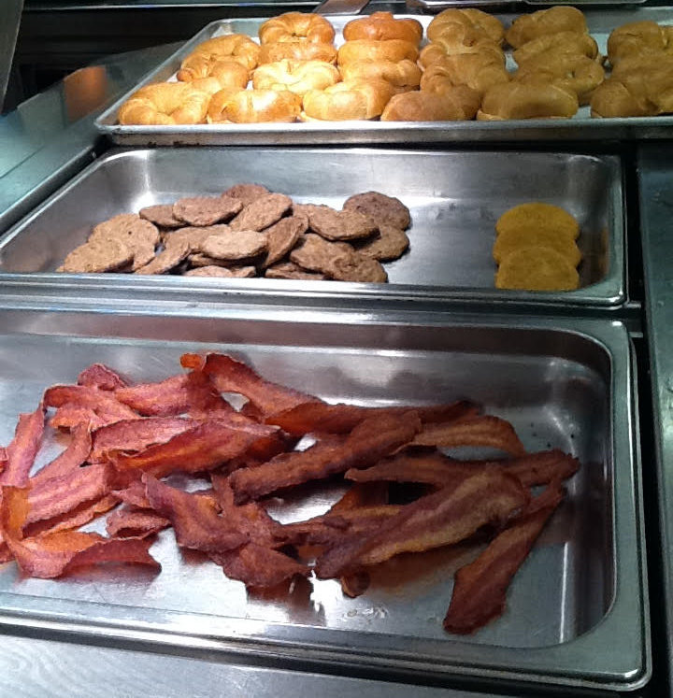
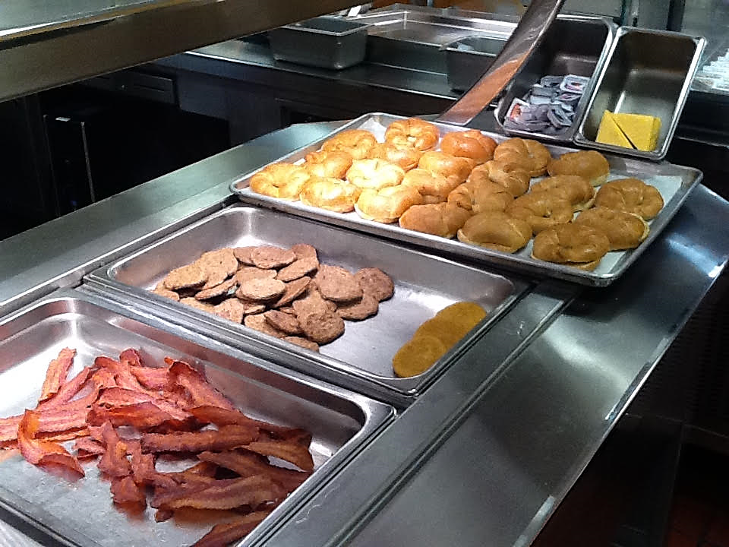
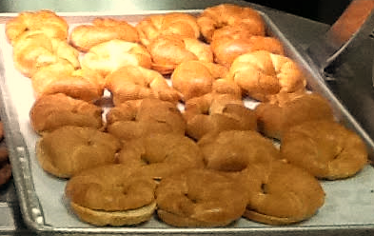
Ideas worth sharing
Build Your Own Breakfast

Slide 2
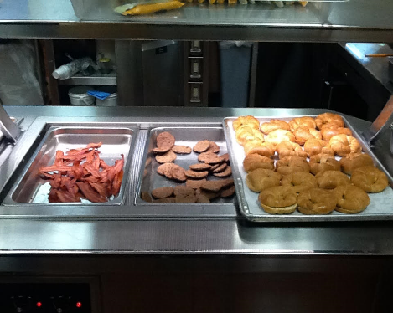
Build Your Own Breakfast Overview
Why Breakfast?
Which Items?
Why BYOB works?

Slide 3
Key Learnings
Districts:
Start small
Manage customer choices
Provide meat and non-meat options
Involvement builds commitment…and participation!
Measure results
Expand choice to more items/entrees/meals
Have FUN!!!

